Slide 1

Assessing the Accuracy of Supervised Learning Models in Forecasting Urban Temperatures in Manchester: A Comparison with Academic Climate Projections
EART60702
Project 2: Group 3
Madeleine Carnell
Silang Nimai
Wanglu Yu

Slide 2

Introduction
Urban temperature forecasting supports climate adaptation for infrastructure, energy, and public health.
We apply machine learning to predict maximum temperatures in Manchester from 2006–2080.
Based on a Multi-Model Ensemble (MME) of climate simulations (6 RCP-driven scenarios).
Machine learning is increasingly used in climate science for pattern detection, time series forecasting, and ensemble modelling (Zennaro et al., 2021).
Compared against CHESS-SCAPE (Robinson et al., 2023), a bias-corrected academic baseline, established in literature as a baseline (Fradgley et al., 2022).
Uses two model types:
LSTM for sequential deep learning (Jose et al., 2022).
Random Forest for ensemble, nonlinear learning (Asadollah et al., 2021)
Also tests stacking: combining model outputs to improve accuracy (Shanmugam and Lakshmanan, 2025).
Citations: (Asadollah, Sharafati and Shahid, 2021; Fradgley et al., 2022; Jose, Vincent and Dwarakish, 2022; Robinson et al., 2023; Shanmugam and Lakshmanan, 2025; Zennaro et al., 2021)

Slide 3
Data preprocessing
MME (6 RCP’s 003–008)
Daily climate simulations from 2006-2080 across UK
Includes 9 variables such as TREFHT, PRECT, FSNS, and others.
CHESS-SCAPE (RCP 8.5)
Monthly projections across UK from 1980 to 2080, downscaled to 1 km resolution (UKCP18-derived)
Used 3 matched variables: tasmax, pr, and rsds
RCP 8.5 = no-mitigation, high-emission pathway (worst-case scenario)
Bias-corrected using historical CHESS-met dataset
Why Monthly CHESS?
Daily data not feasible to download (hundreds of files: 1200 per variable)
Monthly resolution was sufficient for comparative benchmarking

Slide 4
MME Variable | MME Definition | Potential CHESS Variable | CHESS Definition | Notes
TREFMXAV_U | Daily max of average temperature (urban) | tasmax | Daily maximum temperature (K) | Match
FLNS | Net surface longwave flux | rlds | Downward longwave radiation (W/m²) | Not exact: FLNS = net longwave flux (rlds – outgoing)
FSNS | Net solar flux at surface | rsds | Downward shortwave radiation (W/m²) | Match
PRECT | Precipitation rate (liquid) (m/s) | pr | Precipitation rate (kg/m²/s) | Match
PRSN | Snow precipitation rate | - | - | -
QBOT | Water vapour mixing ratio | huss | Specific humidity (kg/kg) | Not the same: huss = specific humidity; qbot = mixing ratio
TREFHT | Reference height temperature | tas | Daily mean air temperature (K) | Similar, but TREFHT = reference height temp
UBOT/VBOT | Zonal/Meridional wind at lowest model level | sfcwind | Wind speed (m/s) | sfcwind = magnitude only; UBOT/VBOT = vector components

Slide 5

Transformations
Final Dataset
Location Filtering: Extracted only the Manchester grid cell from both datasets (lat 53.25, lon -2.5)
Time Standardisation
MME: Decoded time index from “days since 2006-01-01”
CHESS: Kept as monthly resolution
Leap years removed for model consistency across datasets
Unit Conversions
TREFMXAV_U: Kelvin to Celsius
PRECT: Standardised to m/s
lon: Transformed from 360° format to -180 to 180° for consistency
Feature Alignment:
Renamed and aligned feature columns
NaNs for missing variables in CHESS (0085)
Combined into a single, unified dataframe
Model Column added to distinguish source (003–008, 0085)
7 Models (03-08 MME and 0085)
165,000+ daily entries from 2006 to 2080
8 predictor variables (where available)
TREFMXAV_U used as the target variable across all sources
Notes:
Location Filtering:
Extracted only the Manchester grid cell from both MME and CHESS datasets
Coordinates: approx. lat 53.25, lon -2.5
Time Standardisation:
MME: Decoded time index from “days since 2006-01-01”
CHESS: Kept as monthly resolution (no interpolation applied)
Leap years removed for model consistency across datasets
Unit Conversions:
TREFMXAV_U: Converted from Kelvin to Celsius
PRECT: Standardised to m/s
lon: Transformed from 0–360° format to -180–180° for consistency
Feature Alignment:
Renamed and aligned feature columns across datasets
Resulted in NaNs for missing variables in CHESS (0085) — this was expected and handled

Slide 6
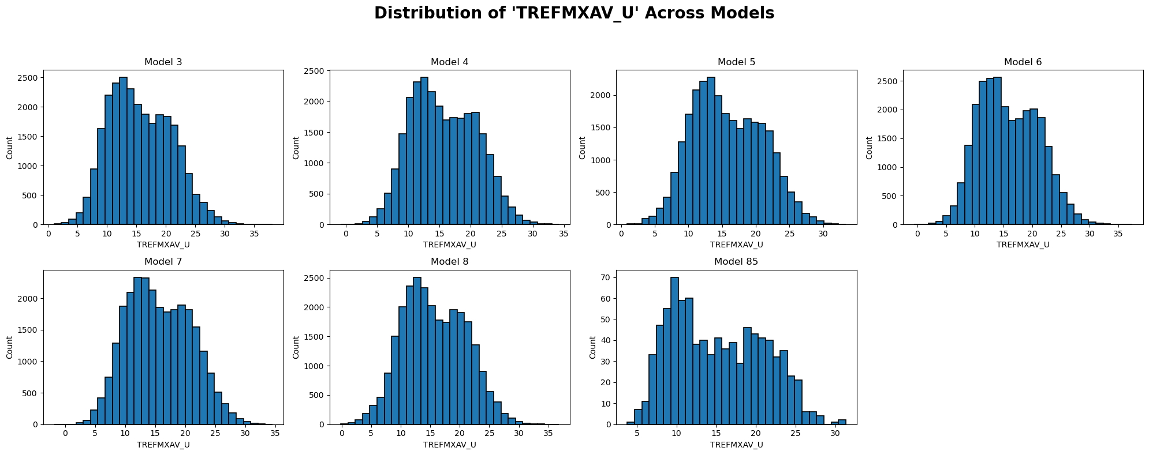
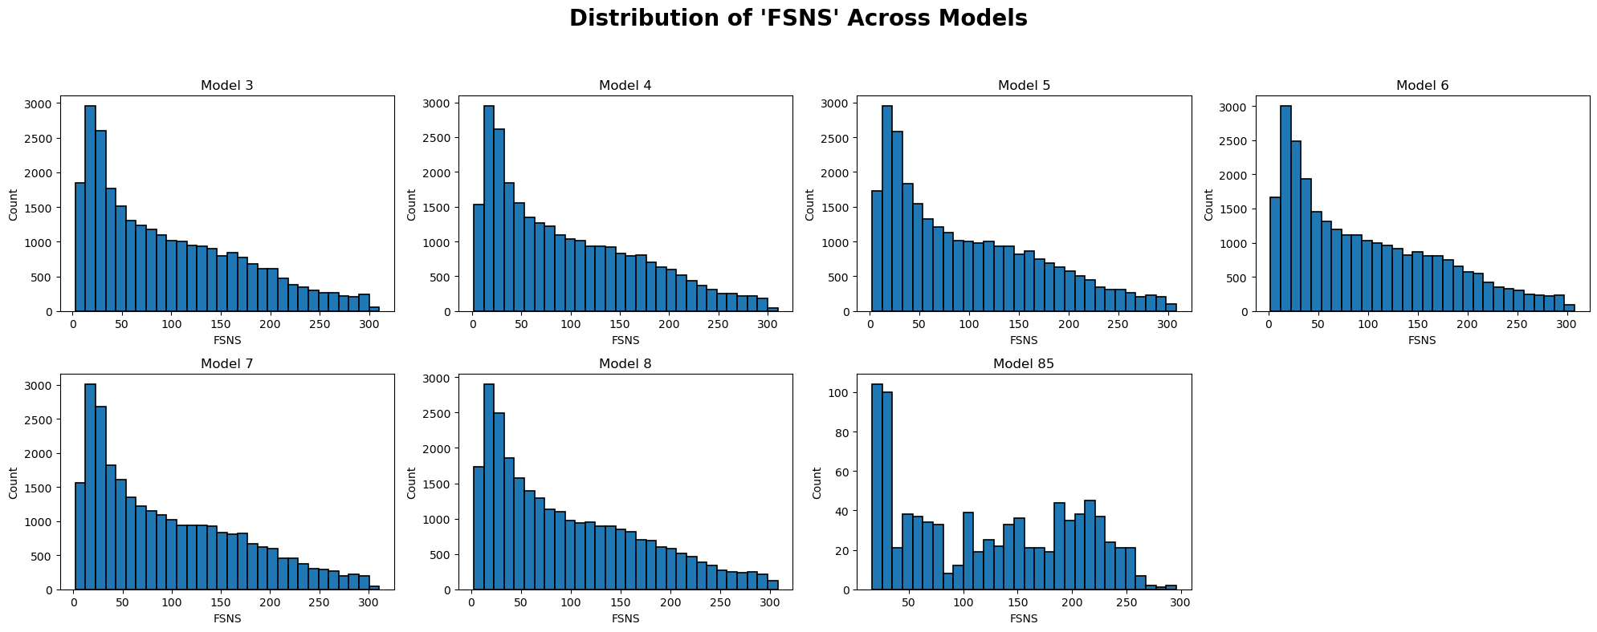
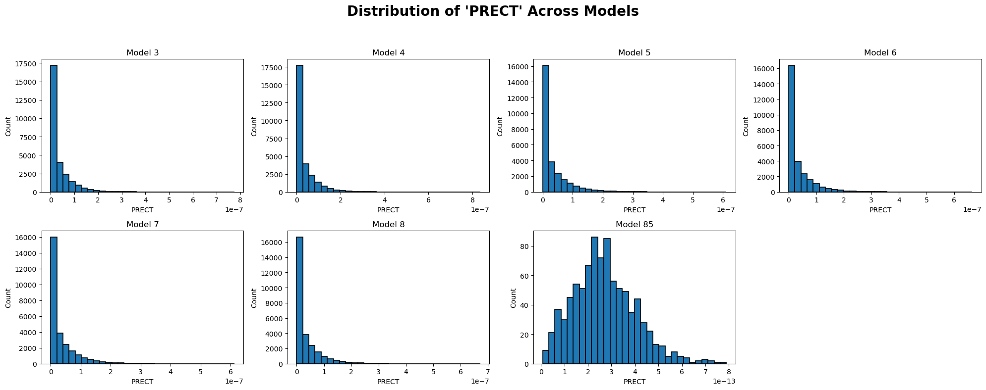
EDA-Variable Distribution

Slide 7
Both variables show right skewness across models, but FSNS is more smoothly distributed.

Slide 8
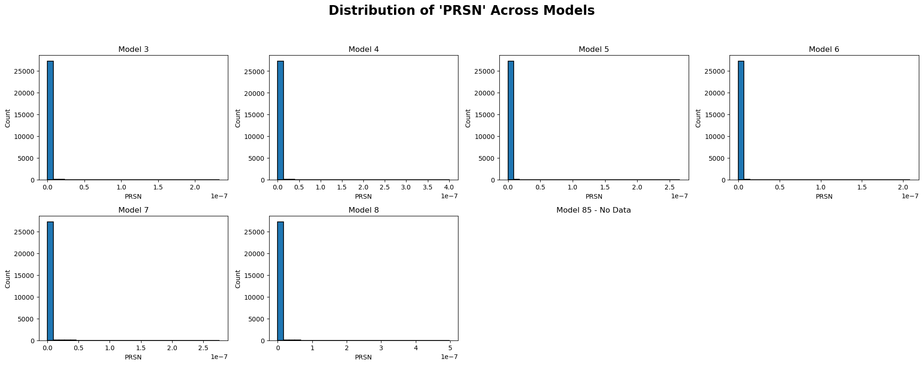
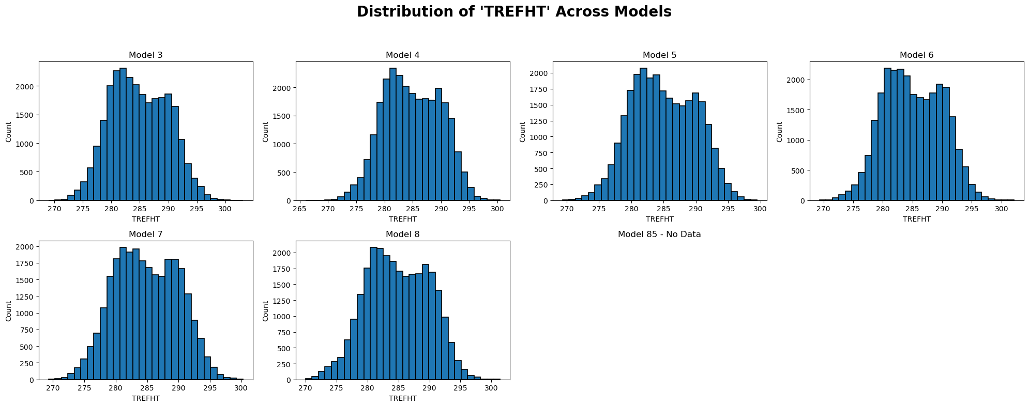

Slide 9
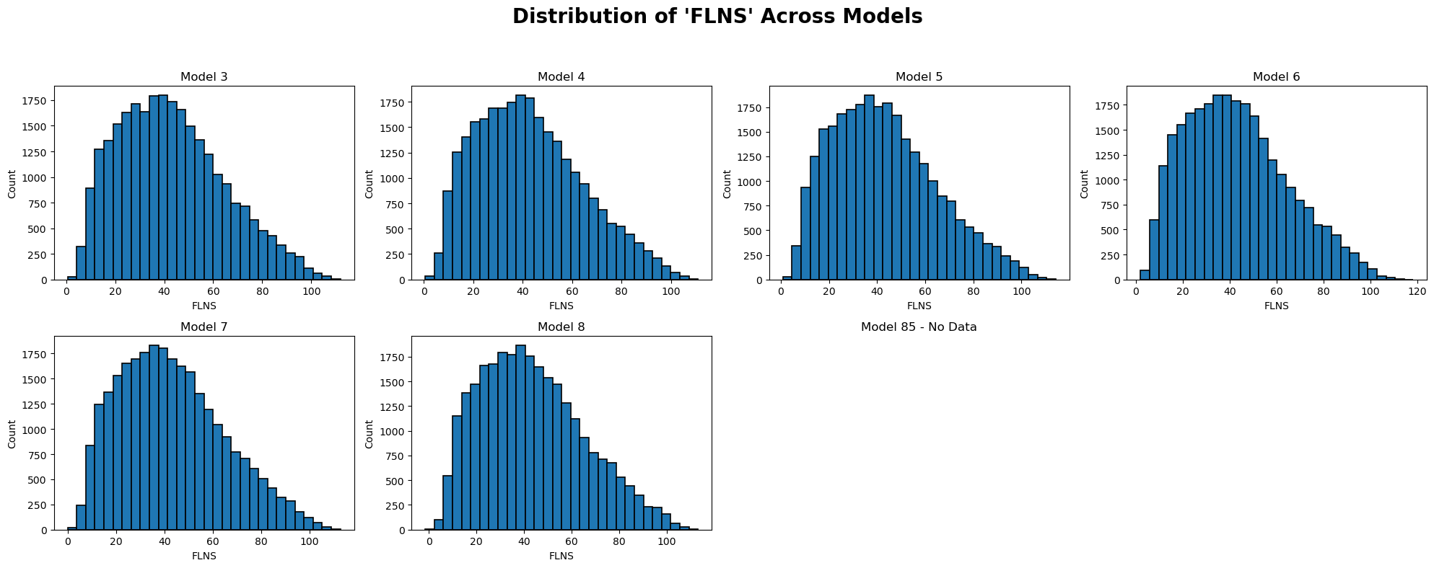
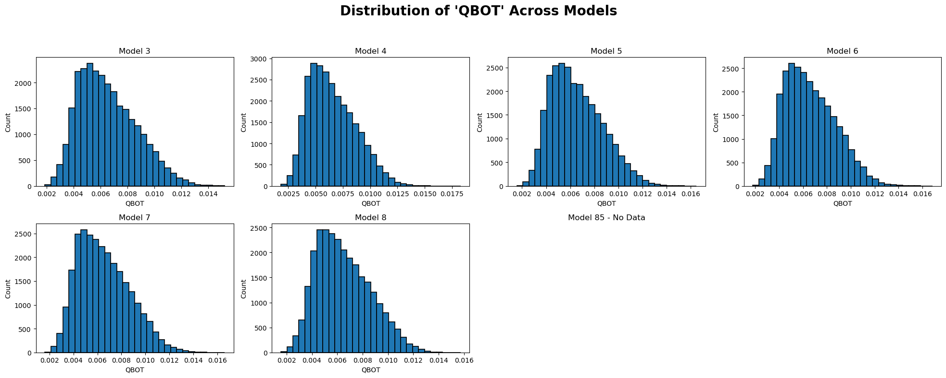

Slide 10
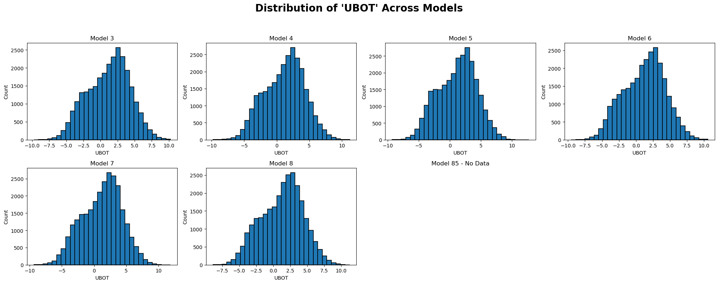
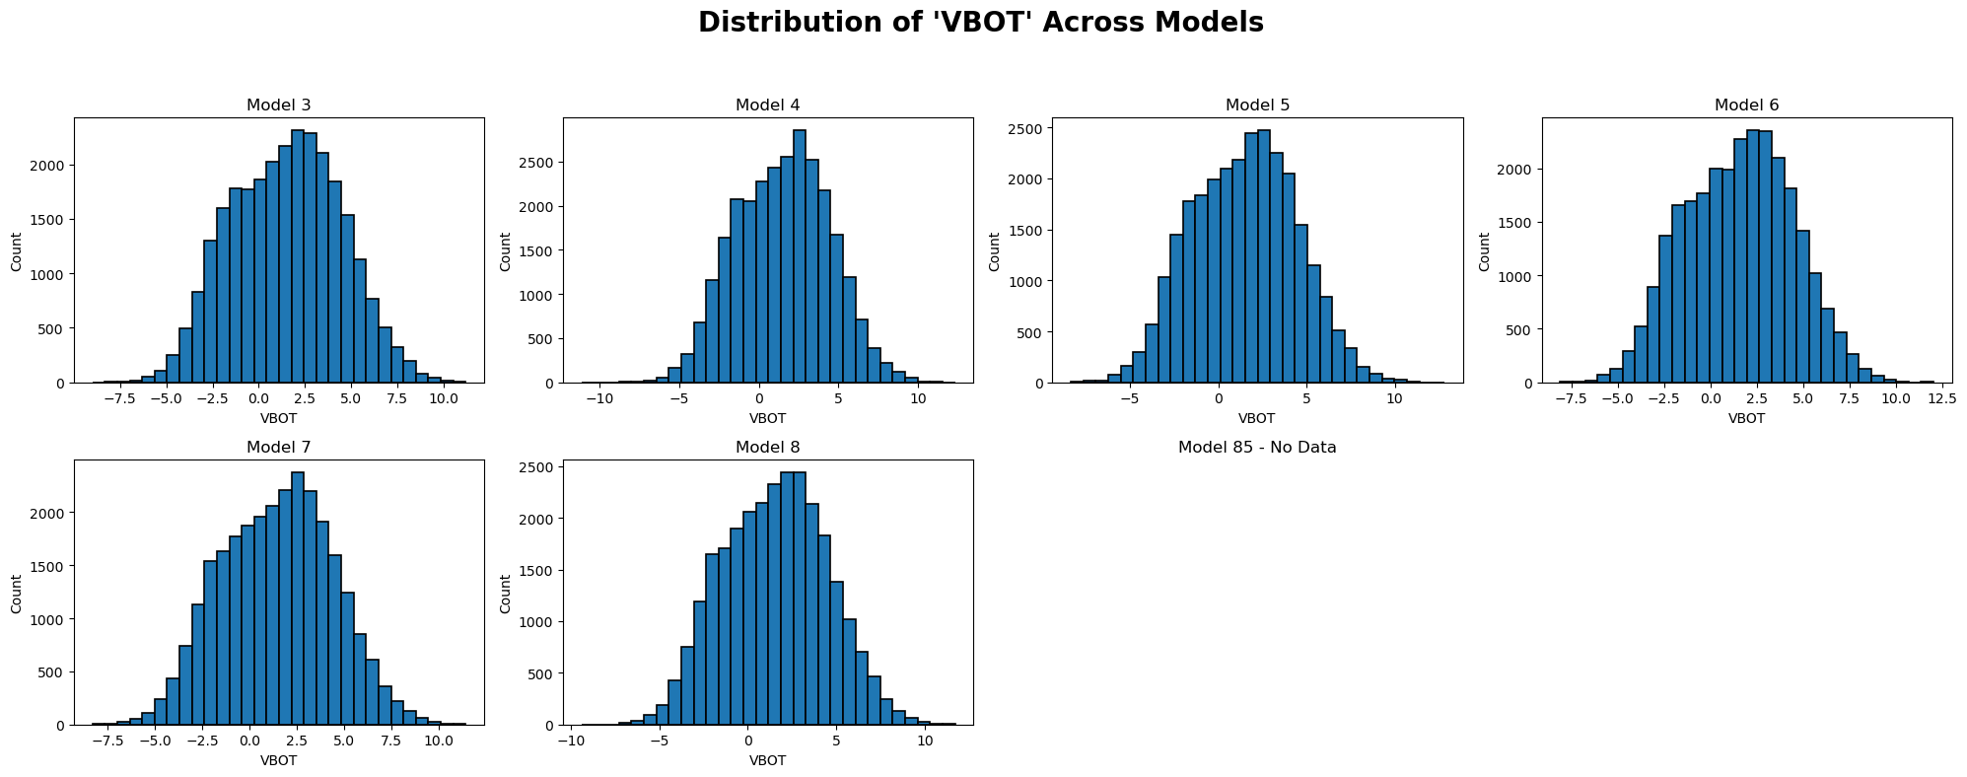
Both UBOT and VBOT show symmetrical bell-shaped distributions, indicating low skewness.

Slide 11
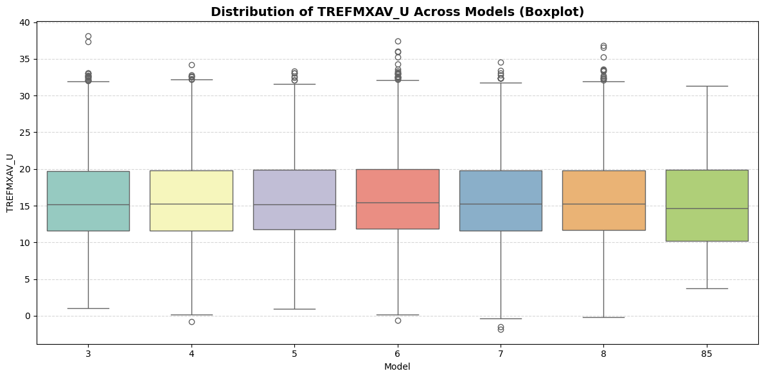
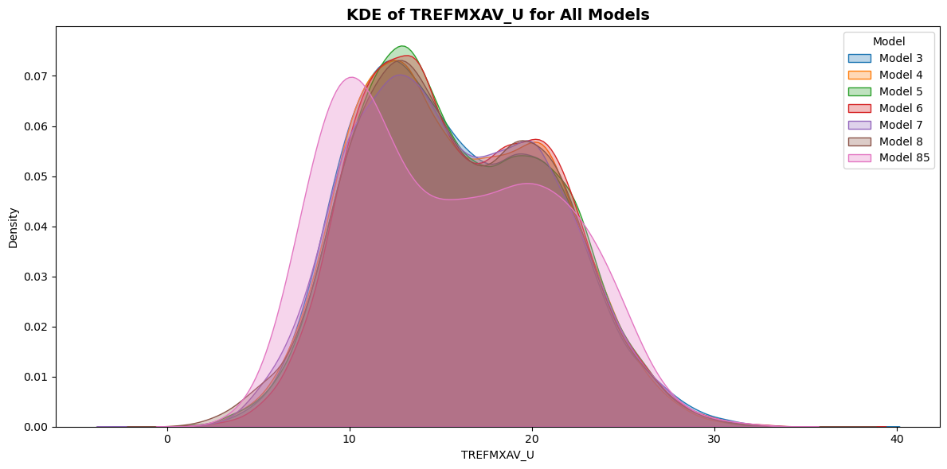
Temperature Distribution

Slide 12
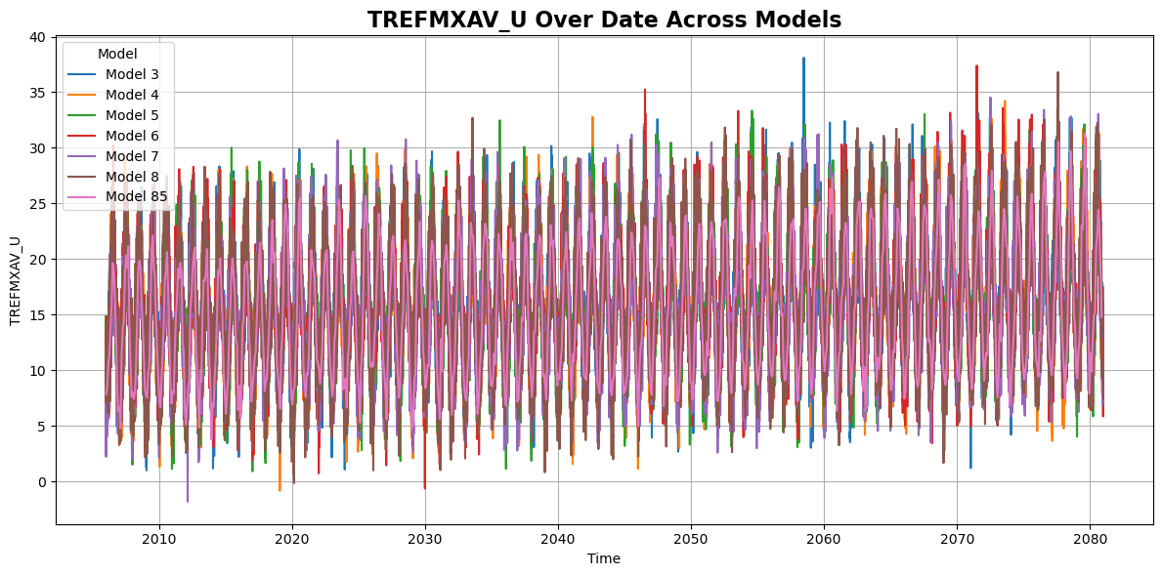
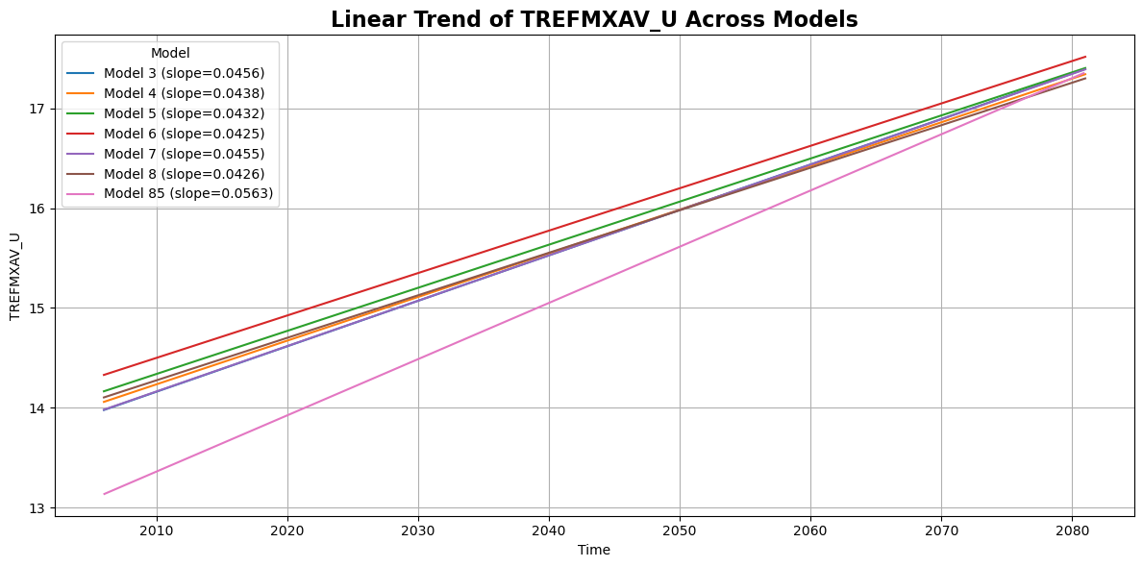
Time Series

Slide 13
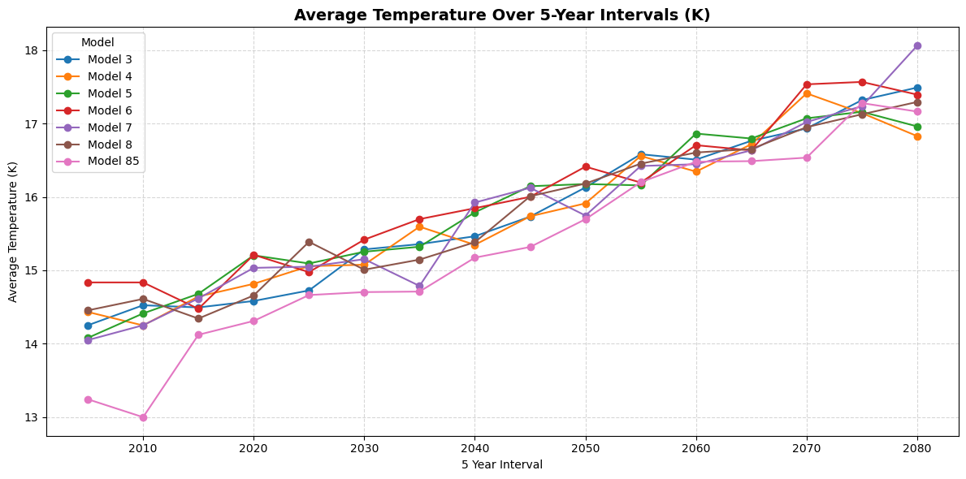

Slide 14
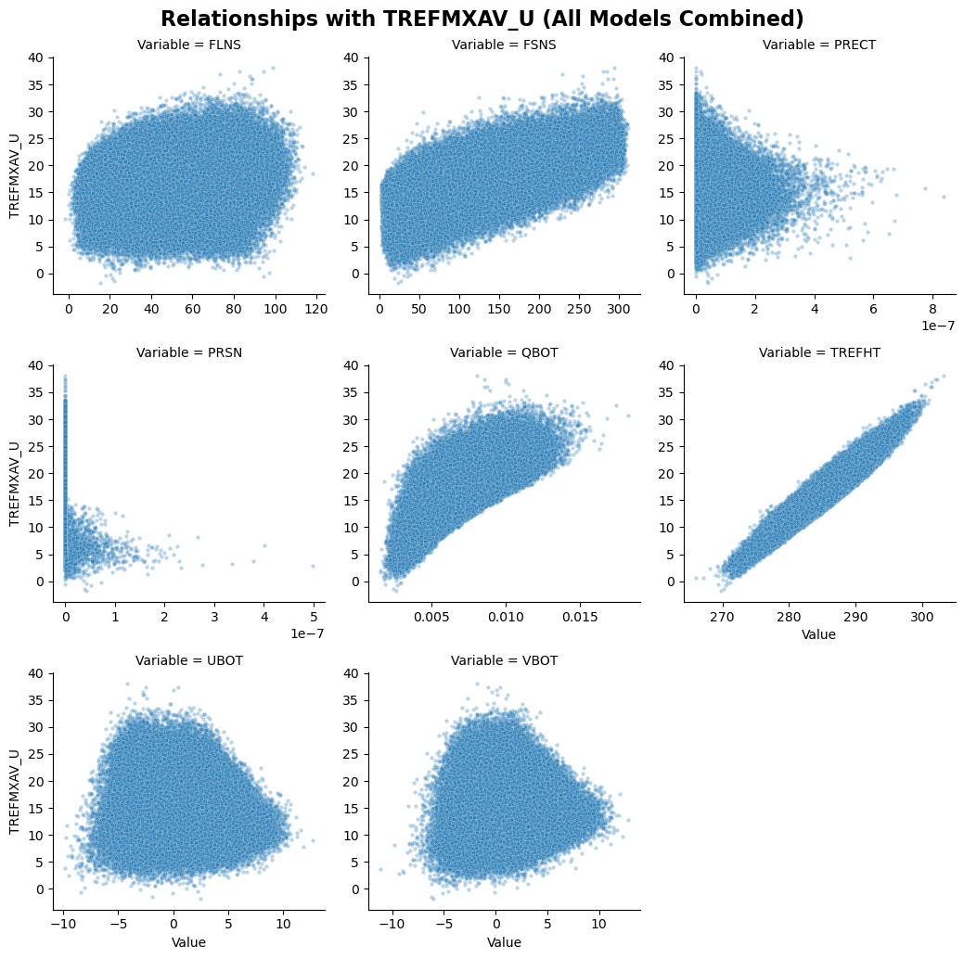
Clear positive correlation with TREFHT & FSNS.
Weak or no relationship with FLNS, UBOT, VBOT.

Slide 15
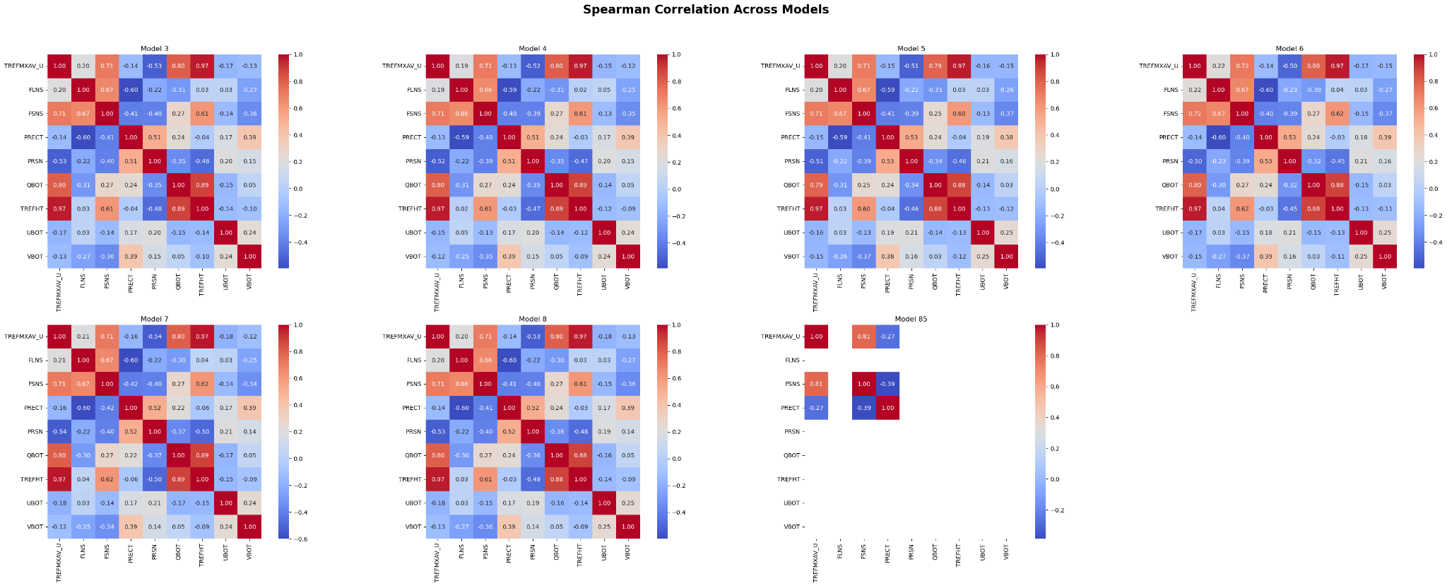
Correlation Matrices

Slide 16
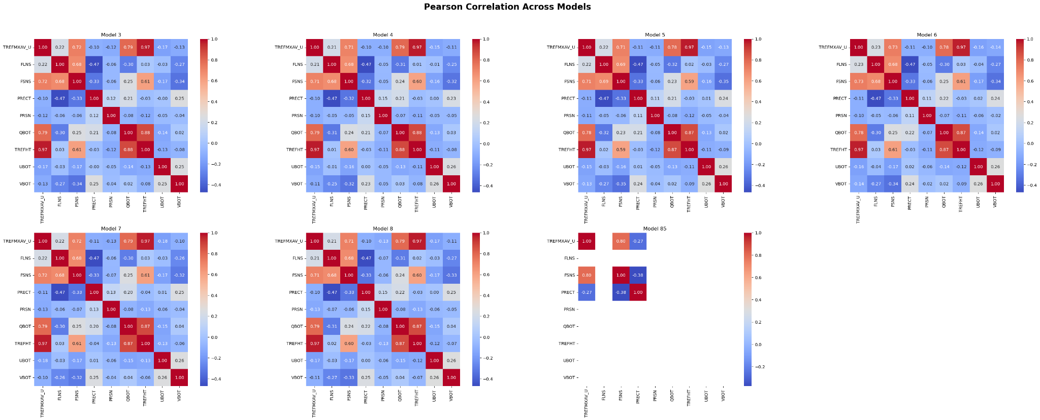
Pearson correlations are weaker, confirming non-normality in data.

Slide 17
Model

Slide 18
Long Short-Term Memory (LSTM）
Separate Application of LSTM to the 6 original Datasets (Model 3-8)
Model Design:
Component | Details
Input Sequence Length | 7 days
Input Features | 'FLNS', 'FSNS', 'PRECT', 'PRSN', 'QBOT', 'TREFHT', 'UBOT', 'VBOT'
Units | 20
Loss Function | Mean Squared Error (MSE)
Optimizer | Adam
Epochs | 20
Dataset Splitting (Daily)：
Training set: 2006-1-1 to 2040-12-31
Validation set : 2041-1-1 to 2049-12-31
Testing set : 2050-1-1 to 2080-12-30

Slide 19
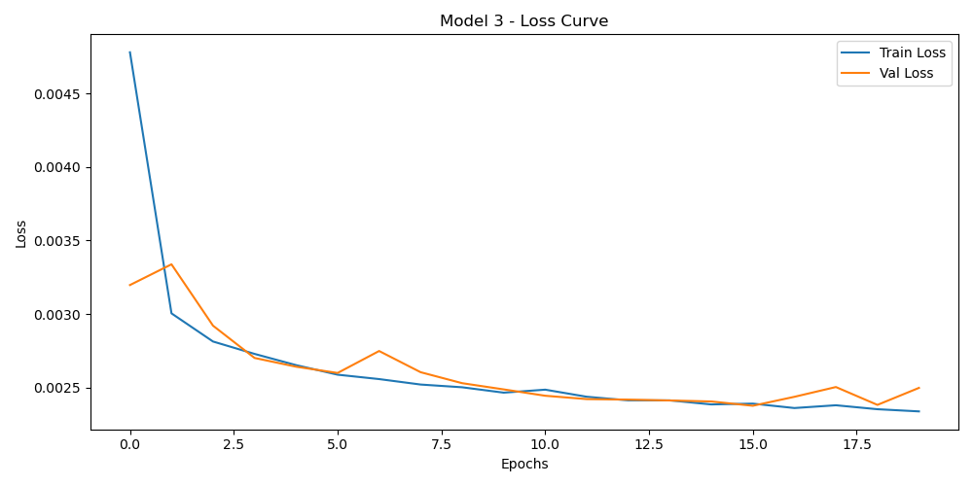
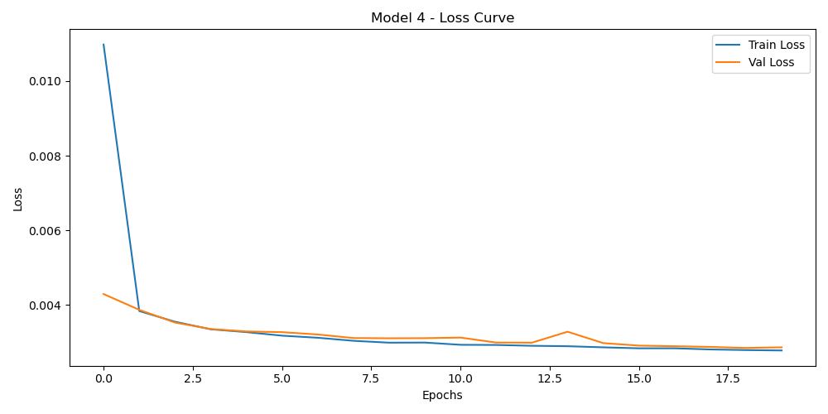
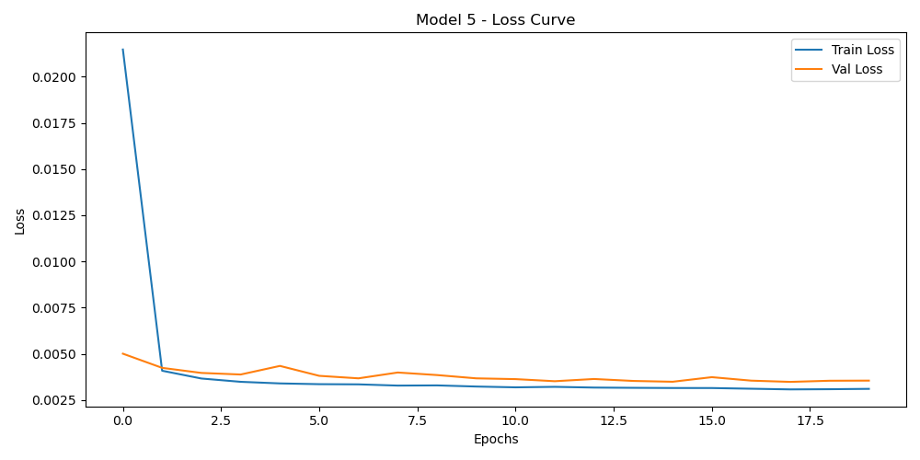
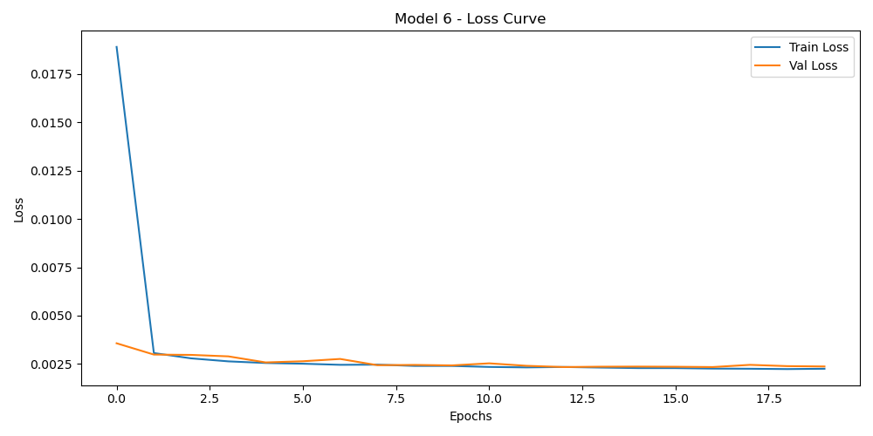
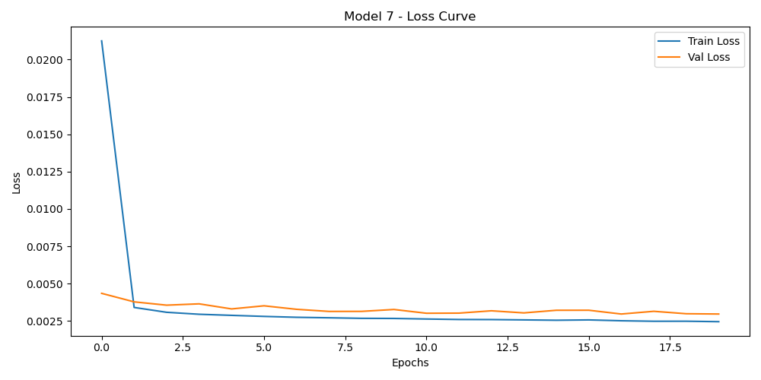
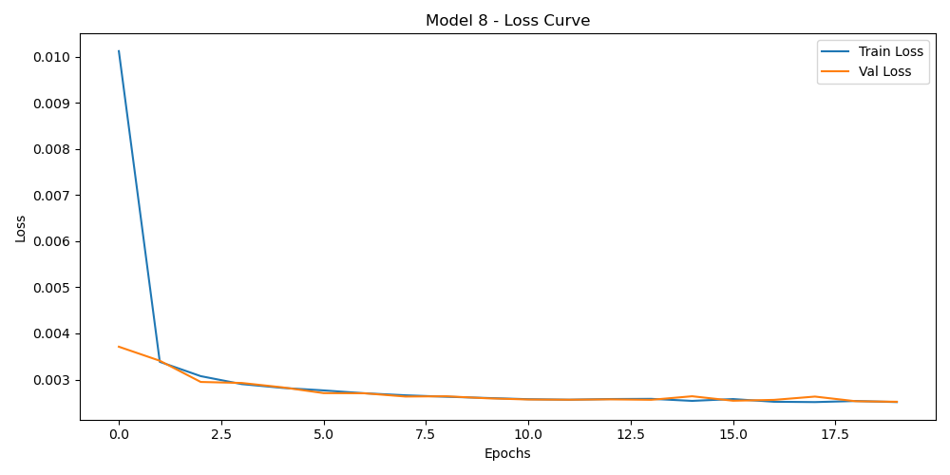
For all six models, the training and validation loss curves demonstrate consistent convergence without signs of overfitting or underfitting.
Loss Curves of the Six Models

Slide 20
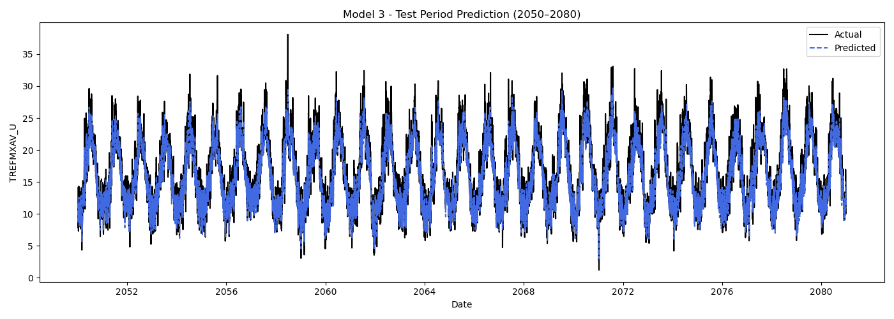
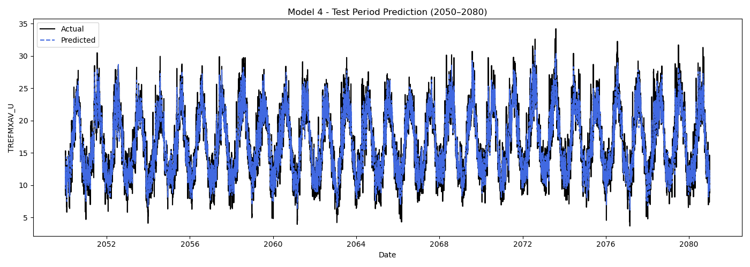
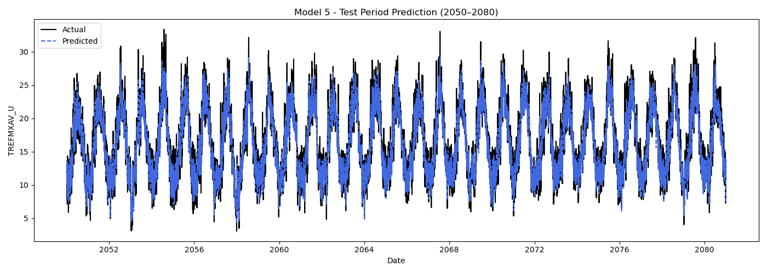
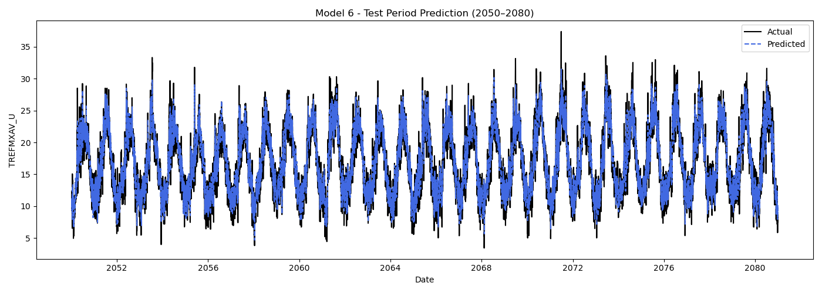
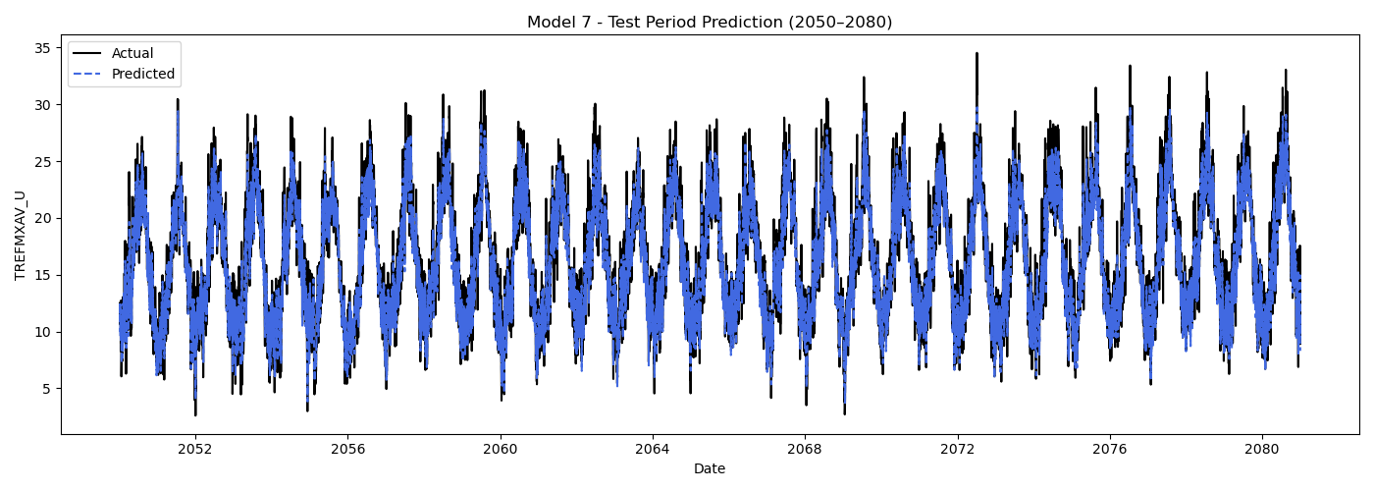
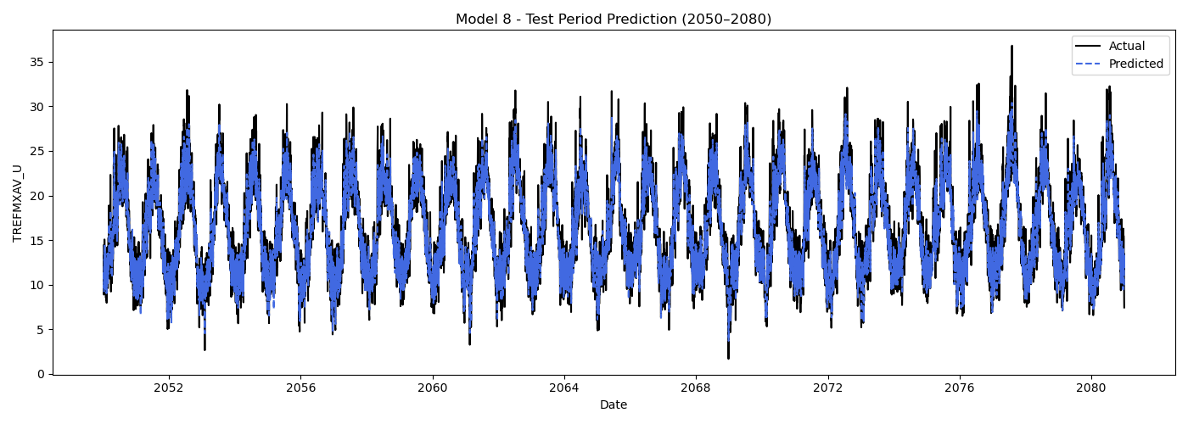
Prediction Results of the Six Test Sets
 | MME_03 | MME_04 | MME_05 | MME_06 | MME_07 | MME_08
RMSE | 1.95 | 1.87 | 1.88 | 2.13 | 1.94 | 1.98

Slide 21
Long Short-Term Memory (LSTM）
2. Application of LSTM to the CHESS Dataset (Model 85)
Model Design:
Component | Details
Input Sequence Length | 3 months (3 steps)
Input Features | 'PRECT', 'FSNS'
Units | 20
Loss Function | Mean Squared Error (MSE)
Optimizer | Adam
Epochs | 20
Dataset Splitting (Monthly)：
Training set: 2006-1 to 2040-12
Validation set : 2041-1 to 2049-12
Testing set : 2050-1 to 2080-12

Slide 22
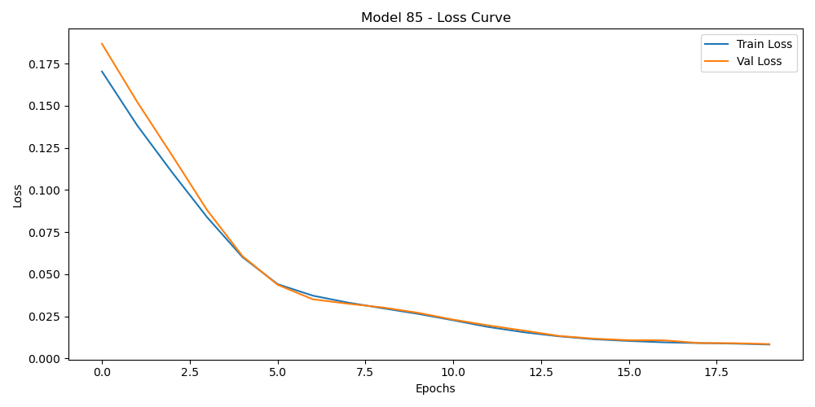
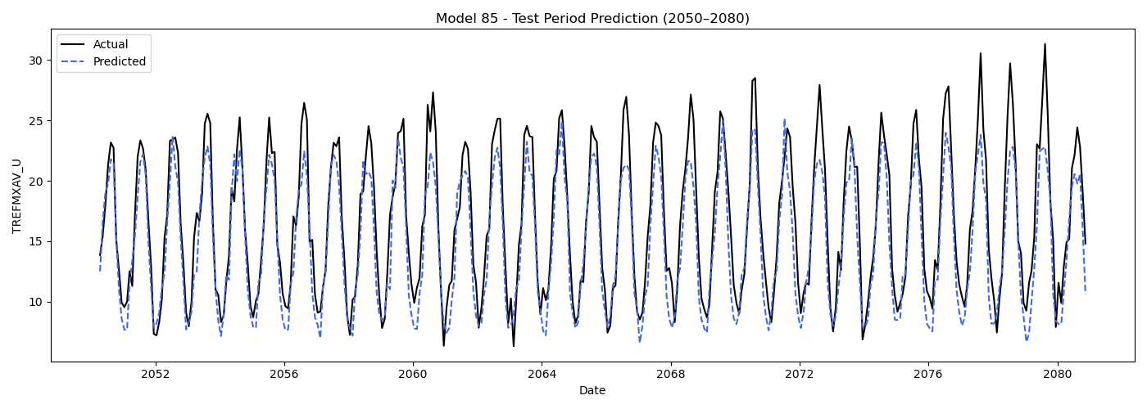
Results:
The model did not exhibit overfitting or underfitting.
The RMSE value of the model is 3.32.
Loss Curves of Model 85
Prediction Results of Model 85

Slide 23
Random Forest (RF)
Application of RF to the 6 original Datasets (Model 3-8)
Model Design:
Component | Details
Input Sequence Length | 7 days (sliding window)
Input Features | 'FLNS', 'FSNS', 'PRECT', 'PRSN', 'QBOT', 'TREFHT', 'UBOT', 'VBOT'
Number of Trees | 30
Evaluation Metric | Root Mean Squared Error (RMSE)
Dataset Splitting (Daily)：
Training set: 2006-1-1 to 2040-12-31
Validation set : 2041-1-1 to 2049-12-31
Testing set : 2050-1-1 to 2080-12-30

Slide 24
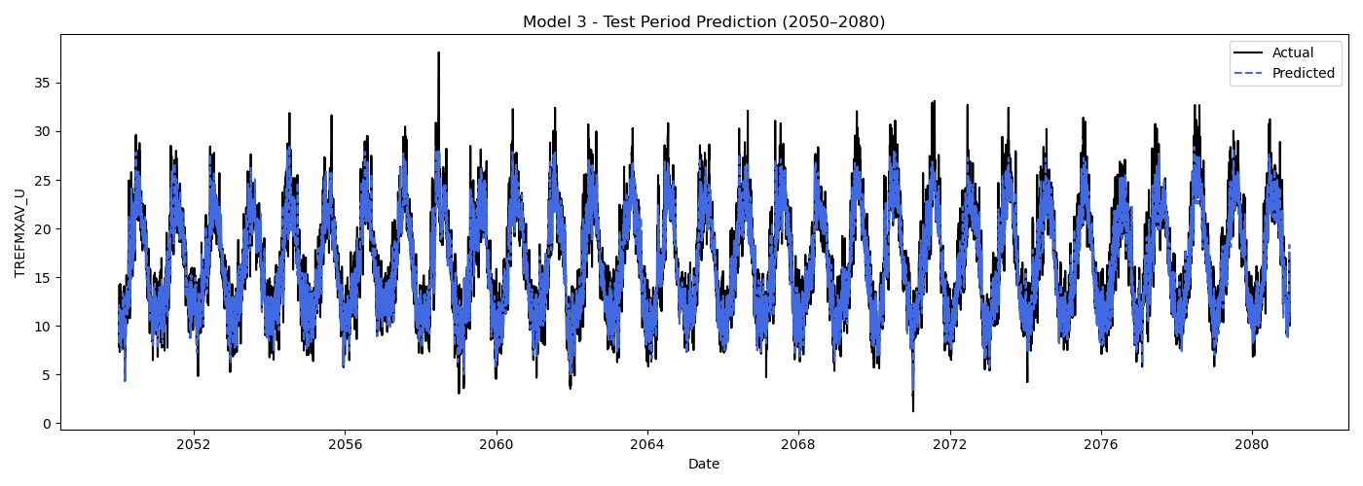
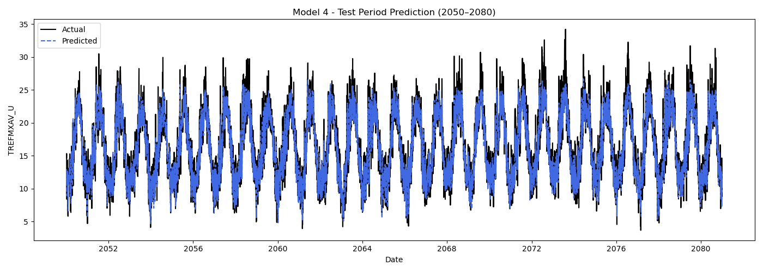
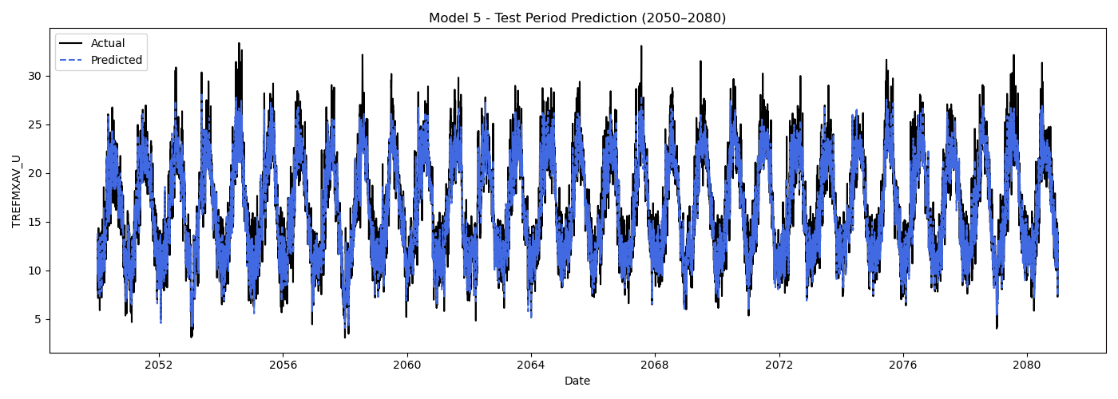
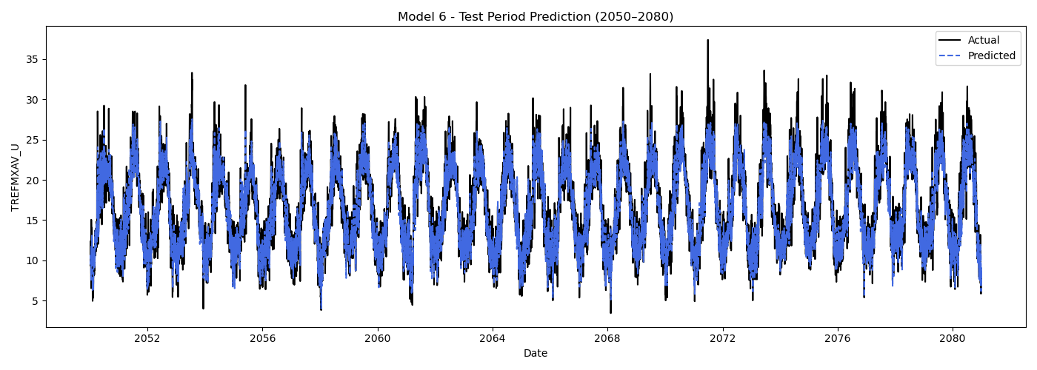
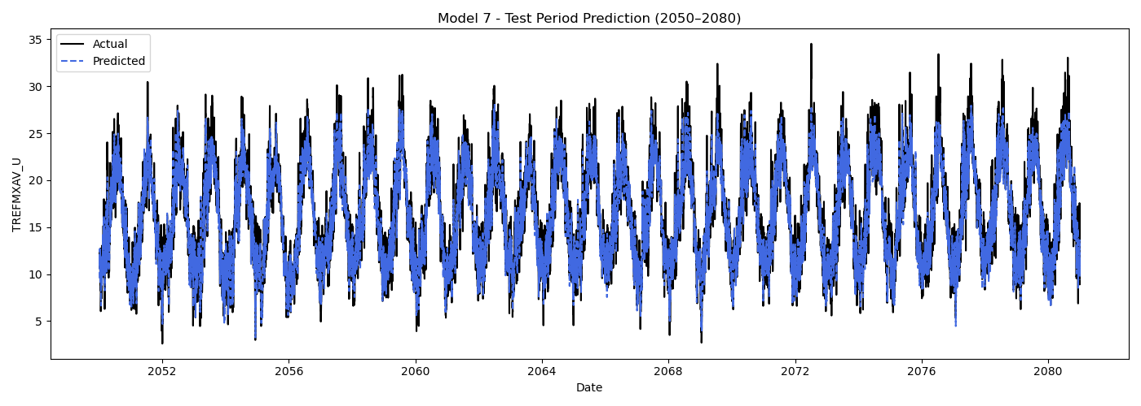

Prediction Results of the RF Sets
 | MME_03 | MME_04 | MME_05 | MME_06 | MME_07 | MME_08
RMSE | 2.03 | 1.98 | 1.97 | 2.02 | 2.04 | 2.06

Slide 25
Random Forest (RF)
2. Application of RF to the CHESS Dataset (Model 85)
Model Design:
Component | Details
Input Sequence Length | 3 months (3 steps)
Input Features | 'PRECT', 'FSNS'
Number of Trees | 30
Evaluation Metric | Root Mean Squared Error (RMSE)
Dataset Splitting (Daily)：
Training set: 2006-1-1 to 2040-12-31
Validation set : 2041-1-1 to 2049-12-31
Testing set : 2050-1-1 to 2080-12-30

Slide 26
Prediction Results of Model 85
Prediction Results of Model 85
Results:
The model did not exhibit overfitting or underfitting.
The RMSE value of the model is 2.58.

Slide 27
Stacking
A method that uses the prediction results of multiple models as new features to train a meta-model for final prediction.
Experiment design
Stacking_1:
All four variables were simultaneously input into the model, and Random Forest was used for training and prediction.
Stacking_2:
The variables LSTM_day and RF_day were input into the model, and Random Forest was applied for training and prediction.
Dataset Splitting (Daily)：
Training set: 2006-4-1 to 2040-12-31
Testing set : 2050-4-1 to 2080-11-30
Input features：
a. LSTM predictions based on the original model (LSTM_day)
b. RF predictions based on the original model (RF_day)
c. LSTM predictions based on Model 85 (LSTM_85)
d. RF predictions based on Model 85 (RF_85)
Note:Since LSTM_85 and RF_85 are monthly-scale prediction data, linear interpolation was applied.

Slide 28
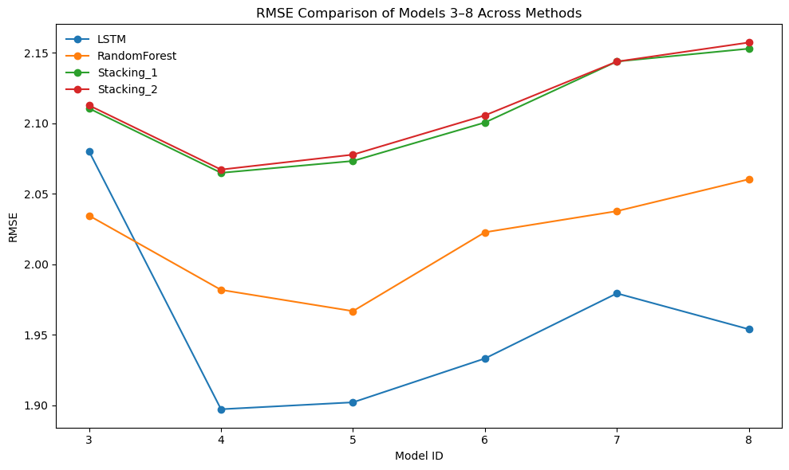
Stacking
Results:
LSTM is the most stable and accurate prediction method.
Neither of the two Stacking methods provides significant improvement; instead, their RMSE values are higher than those of the base learners in several models.
Discussion: The poor performance may be attributed to the fact that:
The monthly-scale outputs from Model 85 introduced noise.
The high correlation between LSTM_day and RF_day may have hindered the model’s ability to learn effective weighting relationships.
RMSE comparison of models 3-8 across methods

Slide 29
Conclusion
Model Performance
LSTM consistently achieved the lowest RMSE across models, indicating superior capability in capturing temporal dynamics of temperature.
Random Forest performed well but was slightly less accurate, particularly on the CHESS dataset.
Model 85 (CHESS-SCAPE) showed higher RMSE across both model types, likely due to:
Monthly resolution introducing interpolation error.
Limited number of matched predictors.
Stacking Results
Combining LSTM and RF predictions did not improve accuracy.
Likely hindered by:
High correlation between input predictions.
Temporal resolution mismatch (daily vs. monthly).
Broader Implications
All models projected a clear upward trend in maximum temperatures to 2080.
Reliable temperature forecasting is achievable with machine learning, but model and data resolution alignment is crucial.

Slide 30
Any Questions?
Thank you for listening

